Slide 1

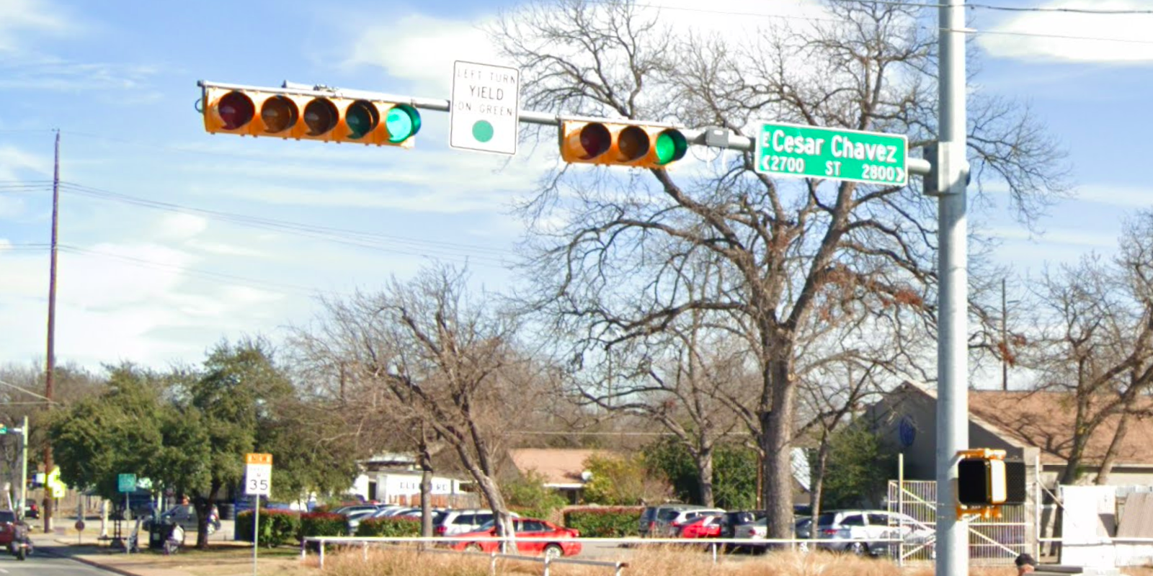
Austin Transportation Department Signs Work Orders
Created By: Susanne Gov Created Date: 2020-08-10 Location Name: CESAR CHAVEZ ST / PLEASANT VALLEY RD Intersection ID: 5160822 Cardinal Direction: N Work Order ID: SG-20366
Sign Type | Install/Remove
Left Turn Yield On Green | Install
Street Name Sign | Install

Slide 2
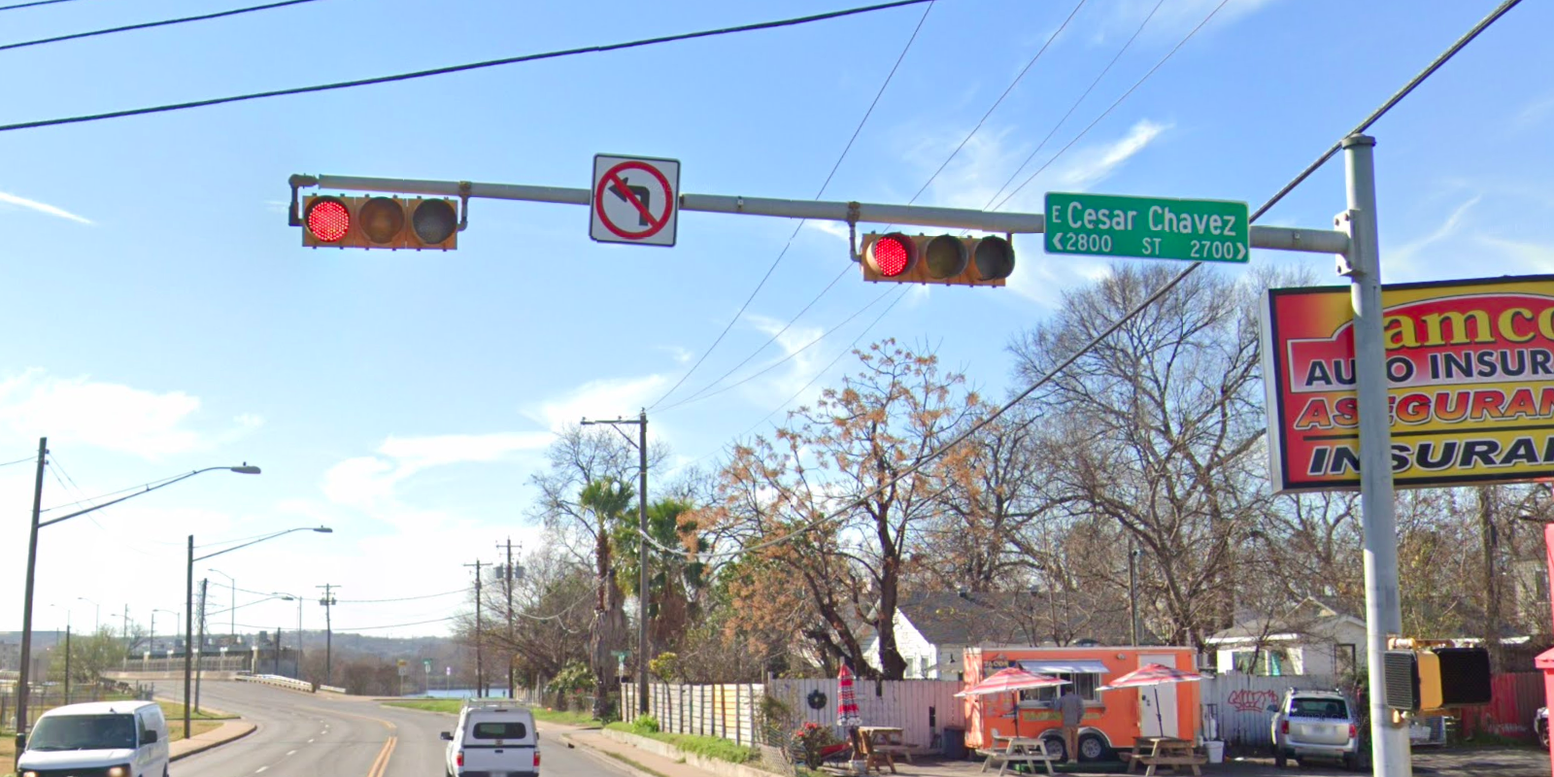
Austin Transportation Department Signs Work Orders
Created By: Susanne Gov Created Date: 2020-08-10 Location Name: CESAR CHAVEZ ST / PLEASANT VALLEY RD Intersection ID: 5160822 Cardinal Direction: S Work Order ID: SG-20366
Sign Type | Install/Remove
Street Name Sign | Install
No Left Turn Arrow | Install

Slide 3
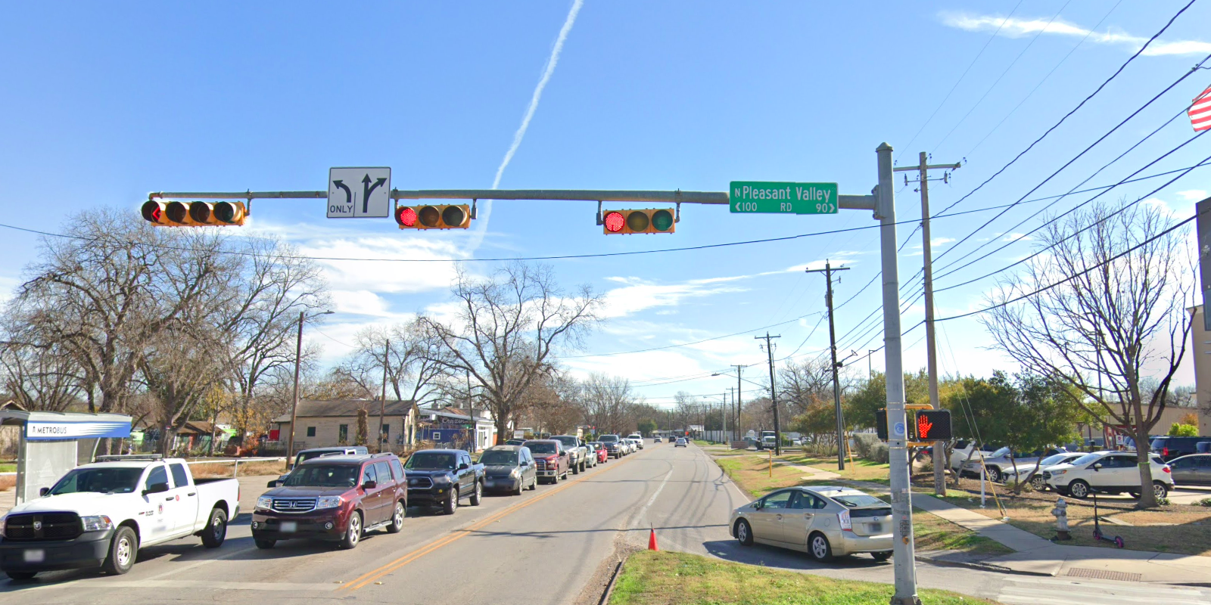
Austin Transportation Department Signs Work Orders
Created By: Susanne Gov Created Date: 2020-08-10 Location Name: CESAR CHAVEZ ST / PLEASANT VALLEY RD Intersection ID: 5160822 Cardinal Direction: E Work Order ID: SG-20366
Sign Type | Install/Remove
Left Turn Arrow Only | Install
Street Name Sign | Install
Straight Right Arrow | Install

Slide 4
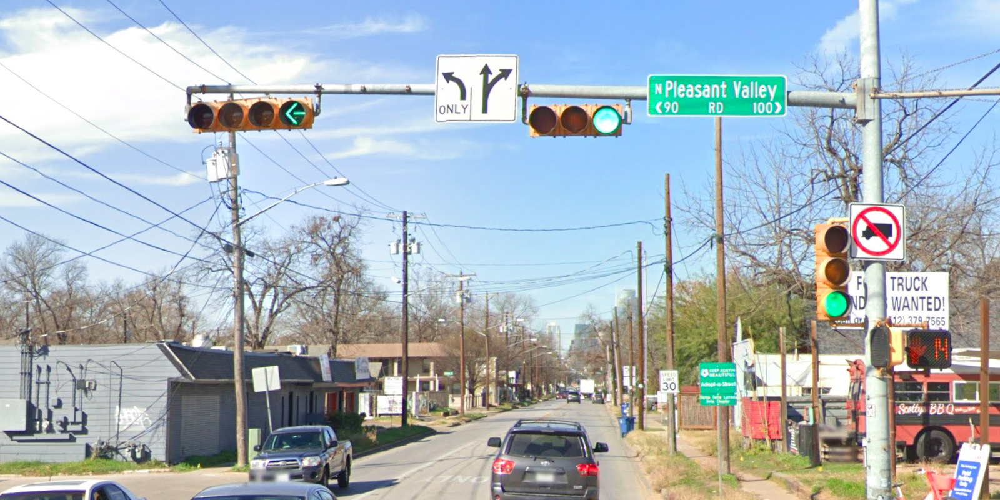
Austin Transportation Department Signs Work Orders
Created By: Susanne Gov Created Date: 2020-08-10 Location Name: CESAR CHAVEZ ST / PLEASANT VALLEY RD Intersection ID: 5160822 Cardinal Direction: W Work Order ID: SG-20366
Sign Type | Install/Remove
Left Turn Arrow Only | Install
Street Name Sign | Install
No Truck Symbol | Install

